Slide 1
Programming Fundamentals Fall 2021
Lecture 6
Dr. Farhan Aadil
farhan.aadil@ciit-attock.edu.pk
DrAadil.com
Please turn OFF your Mobile Phones!

Slide 2
Programming Fundamentals
What are Control Structures?
Decision Statements
If Statements
Switch Statements
Loops

Slide 3
What are Control Structures?
Control structures alter the flow of the program, the sequence of statements that are executed in a program.
They act as "direction signals" to control the path a program takes.
Two types of control structures in Java:
decision statements
loops

Slide 4
Loops
A loop allows you to execute a statement or block of statements repeatedly.
Three types of loops in Java:
1. while loops
2. for loops
3. do-while loops

Slide 5
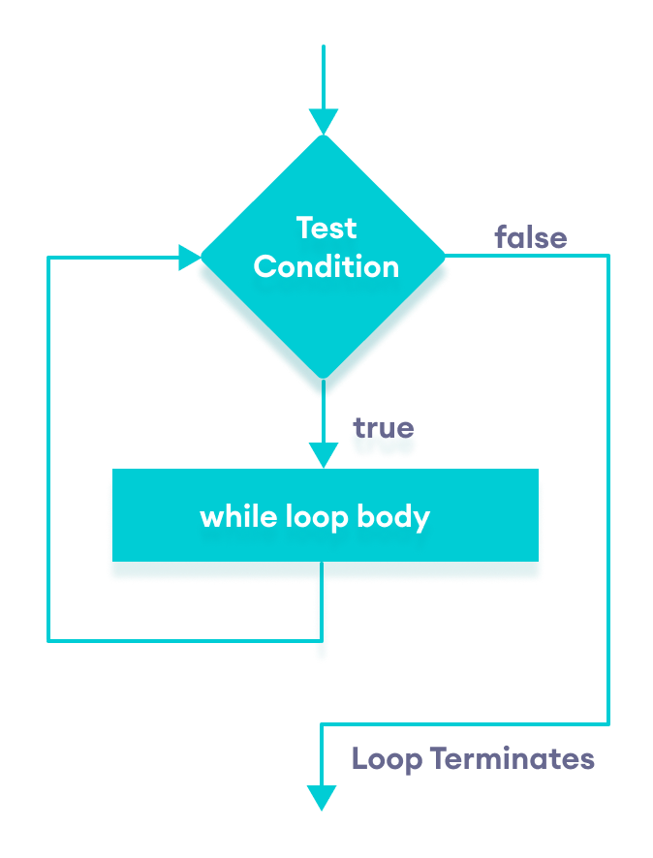
The while Loop Flow

Slide 6
The while Loop syntax
while (expression){ statement
}
This while loop executes as long as the given logical expression between parentheses is true. When expression is false, execution continues with the statement following the loop block.
The expression is tested at the beginning of the loop, so if it is initially false, the loop will not be executed at all.

Slide 7
The while Loop
For example:
int sum = 0;
int i = 1;
while (i <= 10){
sum += i;
i++;
}
What is the value of sum?
1 + 2 + 3 + 4 + 5 + 6 + 7 + 8 + 9 + 10 = 55

Slide 8
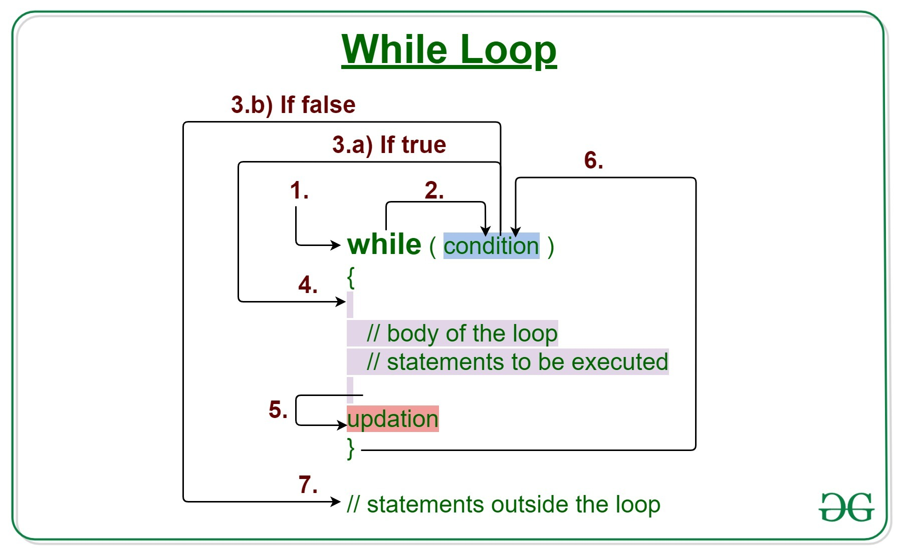
The while Loop

Slide 9
Example
int i = 0;
while (i <= 10){
i++;
}
System.out.println(i);
}
11

Slide 10
Loops
1. while loops
2. for loops
3. do-while loops

Slide 11
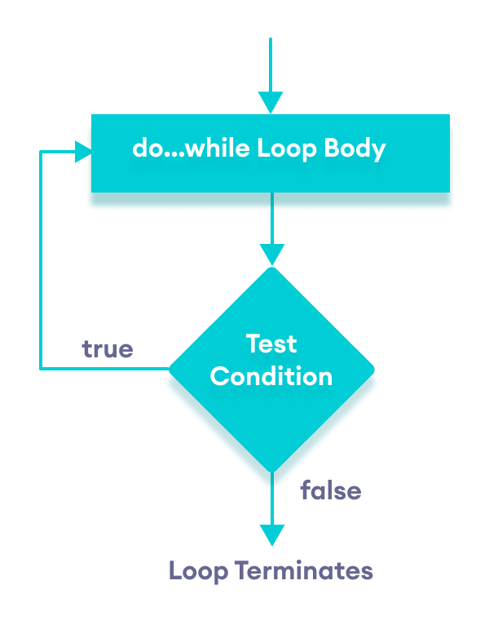
Do-While Loop Flow

Slide 12
Do-While Loop in Java
int counter=15;
do{
System.out.println(counter);
counter ++;
} while(counter<10);

Slide 13
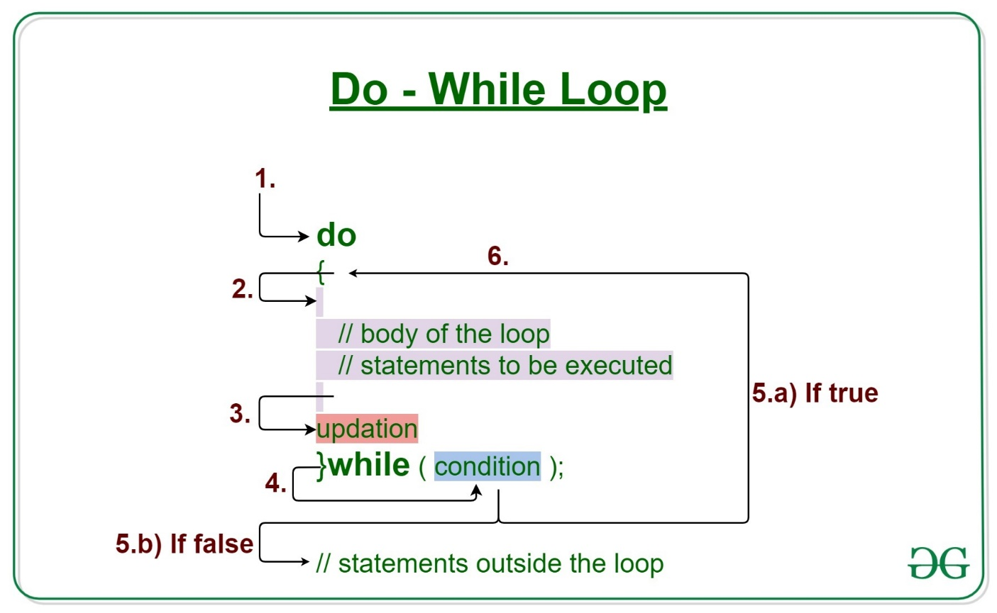
Do-While Loop in Java

Slide 14
Loops
1. while loops
2. for loops
3. do-while loops

Slide 15
The for Loop
Often you write a loop in the following common form:
i = initialValue; // Initialize loop control variable
while (i < endValue)
// Loop body ...
i++; // Adjust loop control variable
A for loop can be used to simplify the preceding loop as:
for (i = initialValue; i < endValue; i++)
// Loop body ...

Slide 16
The for Loop
for (initial-action; loop-continuation-condition; action-after-each-iteration)
{
// Loop body;
Statement(s);
}

Slide 17
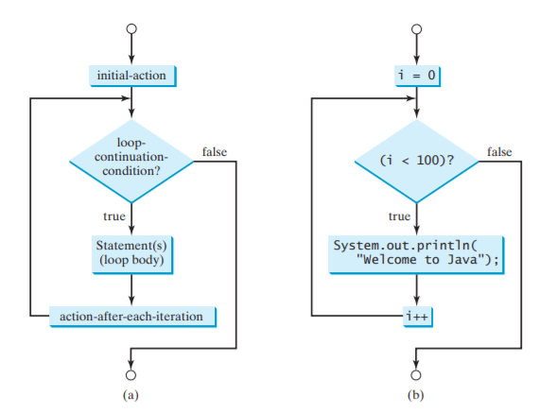
The for Loop flowchart

Slide 18
The for Loop
for (init_expr; loop_condition; increment_expr) { statement;
}
The control of the for loop appear in parentheses and is made up of three parts:
The first part, the init_expression,sets the initial conditions for the loop and is executed before the loop starts.
Loop executes so long as the loop_condition is true and exits otherwise.
The third part of the control information, the increment_expr, is usually used to increment the loop counter. This is executed at the end of each loop iteration.

Slide 19
The for Loop
For example:
int sum = 0;
for (int i = 1; i <= 10; i++) {
sum += i;
}
What is the value of sum?
1 + 2 + 3 + 4 + 5 + 6 + 7 + 8 + 9 + 10 = 55

Slide 20
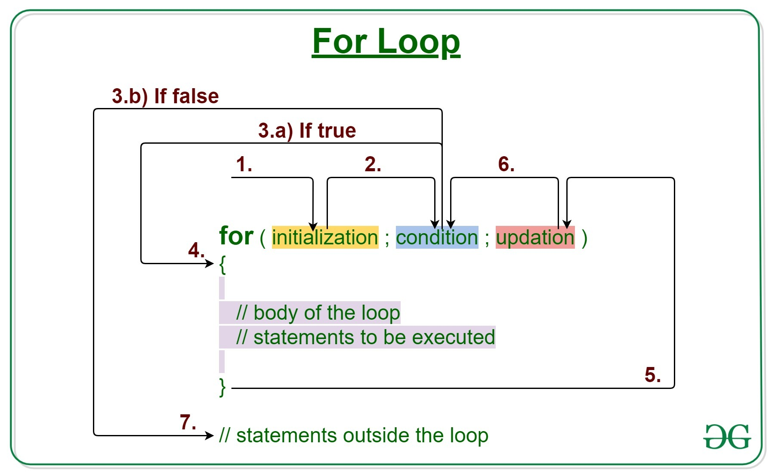
The for Loop

Slide 21
The for Loop
Example :
for(int div = 0; div < 10; div++)
{
if(div % 2 == 0) {
System.out.println("even: " + div);
}
else
{ System.out.println("odd: " + div);}
}
even: 0
odd: 1
even: 2
odd: 3
even: 4
odd: 5
even: 6
odd: 7
even: 8
odd: 9

Slide 22
The for Loop
If there is more than one variable to set up or increment they are separated by a comma.
for(i=0, j=0; i*j < 10; i++, j+=3) { System.out.println(i * j);
}
You do not have to fill all three control expressions but you must still have two semicolons.
int n = 0;
for(; n <= 100;)
{
System.out.println(n++);
}

Slide 23
Break
public static void main(String[] args) {
for(int i=0;i<10;i++)
{
if (i==4)
{
break;
}
System.out.print(i+"\t");
}
0 1 2 3

Slide 24
The continue Statement
public static void main(String[] args) {
for(int i=0;i<10;i++)
{
if (i==4)
{
continue;
}
System.out.print(i+"\t");
}
}
0 1 2 3 5 6 7 8 9

Slide 25
The continue Statement
Another continue example:
int sum = 0;
for(int i = 1; i <= 10; i++){
if(i % 3 == 0) {
continue;
}
sum += i;
}
What is the value of sum?
1 + 2 + 4 + 5 + 7 + 8 + 10 = 37

Slide 26
The continue Statement
The continue statement causes the program to jump to the next iteration of the loop.
for(int m = 5; m < 10; m++) {
if(m == 7) {
continue;
}
System.out.print(m);
}
prints out "5689"

Slide 27
Which Loop to Use?
The while loop and for loop are called pre-test loops because the continuation condition is checked before the loop body is executed.
The do-while loop is called a post-test loop because the condition is checked after the loop body is executed.
The three forms of loop statements—while, do-while, and for—are expressively equivalent; that is, you can write a loop in any of these three forms.

Slide 28
Which Loop to Use?
Use the loop statement that is most intuitive and comfortable for you.
In general, a for loop may be used if the number of repetitions is known in advance, as, for example, when you need to display a message a hundred times.
A while loop may be used if the number of repetitions is not fixed, as in the case of reading the numbers until the input is 0.
A do-while loop can be used to replace a while loop if the loop body has to be executed before the continuation condition is tested.

Slide 29
Difference between for loop and While loop
For loop | While loop
Initialization may be either in loop statement or outside the loop. | Initialization is always outside the loop.
Once the statement(s) is executed then after increment is done. | Increment can be done before or after the execution of the statement(s).
It is normally used when the number of iterations is known. | It is normally used when the number of iterations is unknown.
Condition is a relational expression. | Condition may be expression or non-zero value.
It is used when initialization and increment is simple. | It is used for complex initialization.
For is entry controlled loop. | While is also entry controlled loop.
for ( int i ; condition ; iteration ) { statement(s); } | while ( condition ) { statement(s); }

Slide 30
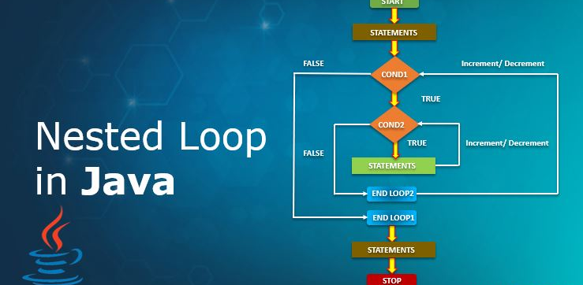
Nested Loops

Slide 31
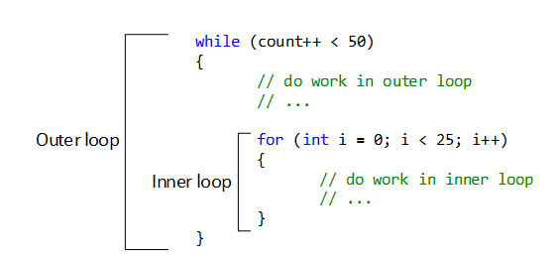
Nested Loops

Slide 32
Important links
My email: farhan.aadil@ciit-attock.edu.pk
My web page: DrAadil.com
Thanks for listening! Ready for Questions & Answers ☺

